Slide 1
Seeds of Hope
Depression, Anxiety and Other Mental Health Issues

Slide 2
Mission Statement: To love and serve others with compassion and clinical excellence. Love heals, we pay witness to its healing process.

Slide 3
Follow Up…..
Healthy Coping Tools
How do I get out of Depression and Stay Out?
How do I help some who has Depression?

Slide 4
Things I can do to help myself /my loved one?
1. Establish or reestablish prayer discipline
2. Be gentle with yourself or your loved one.
3. Establish good sleep hygiene.
4. Establish a healthy diet.
5. Be with friends & family even when it is difficult.
6. Exercise
7. Get outside in the sunshine.
8. Actively participate in counseling.
9. Take medications as directed.
10. Understand it’s a process.
11. Limit Alcohol Intake.
12. ASK FOR PRAYER!!!

Slide 6
Group Support
-Create informal groups
in families and the faith community
Write your own love story
- Witness or Testimony
-Threads of God Presence
- Create a new life in Christ
- Live your new life in Joy

Slide 7
Lens and expectations

Slide 8
Tonight’s ???
What is Anxiety?
Symptoms of Anxiety?
When is Anxiety a problem?

Slide 9
What is Anxiety?
A state consisting of psychological and
physical symptoms brought about by a
sense of apprehension at a perceived
threat. These psychological & physical
symptoms vary greatly according to the
nature and magnitude of the perceived
threat, and from one person to another.

Slide 10
What are the symptoms of Anxiety?
Fear-Actual or perceived
Anger
Insomnia or Hypersomnia
Restlessness
Difficulty Concentrating or Focusing
Panic Attacks
Generalized Anxiety
Social Phobia
Dry mouth, sweating, tremors/shaking
Breathing Changes, increase, difficulty catching your breath or hyperventilation
Muscle Tension
Lump in the throat

Slide 11
What is Optimal Anxiety?
Sweet Spot
Increases Alertness
Increases Concentration and functioning
Decreases Distractibility

Slide 12
1st Line of Defense Memorize Helpful Scripture
In nothing be anxious; but in everything by prayer and supplication with thanksgiving let your requests be made known unto God. And the peace of God, which passeth all understanding, shall guard your hearts and your thoughts in Christ Jesus.
(Philippians 4:6-7)

Slide 13
Do Not Fear x 80

Slide 15
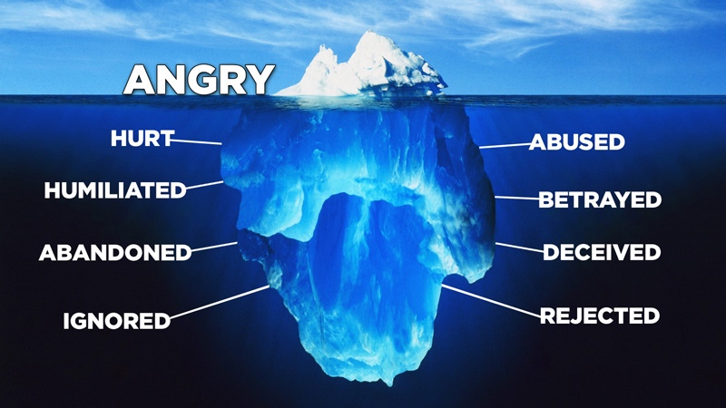

Slide 16
Anger: Can it be Helpful??
Can it move us/propel us into action?
Can it help facilitate a change?

Slide 17
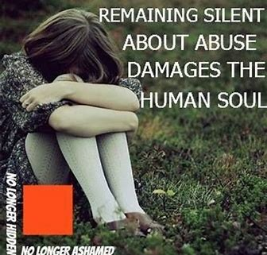
Anger: Can it be Helpful??
Can it move us/propel us into action?
Can it help facilitate a change?

Slide 18
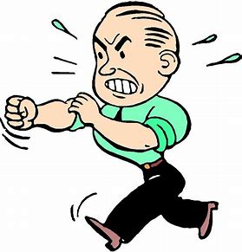
Anger: Can it be Harmful??
How does it feel?
Does it control you?
Does it restrict your life and choices?
Does it make you approachable?
Does it reflect the love of Jesus?

Slide 19
Stop and Think…..

Slide 20
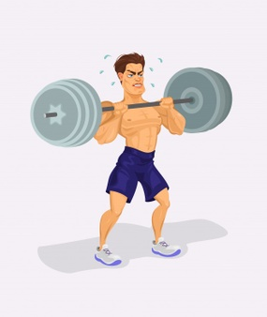

Slide 21
REMEMBER…….
Forgiveness
Condone the Behavior or Offense

Slide 22
Why Forgive??? And forgive us our debts, as we also have forgiven our debtors And lead us not into temptation, but deliver us from the evil (Matthew 6:12-13).
Bear with each other and forgive one another if any of you has a grievance against someone. Forgive as the Lord forgave you (Colossians 3:13).

Slide 23
More Questions..
How do I trust again?
How do I get over fear?

Slide 24
More Questions..
How do I focus my mind?

Slide 26
Treatments
1. Counseling
2. Anti-Anxiety Medication
3. Counseling & Anti-Anxiety Meds

Slide 27
What should I expect in counseling with me?
1. Support
2. Education
3. Feed back and interventions.
4. Prayer support

Slide 28
Should I take a medication?
1. What is best and wise?
2. Seek a trusted medical professional.
3. Find a supportive individual to help you make the best decision about medication.
4. Understand that medications can help alleviate symptoms so that you can do the necessary work in counseling.

Slide 29
The God of all grace, who called us to everlasting glory in Christ, will himself restore, confirm, strengthen and establish those who have suffered a little while. 1 Peter 5:10

Slide 30
1 Peter 4:13 Rejoice in the measure that you share in Christ’s sufferings. When His glory is revealed, you will rejoice exultantly. 1 Peter 4:13 REJOICE sounds paradoxical to Depression or Anxiety. But so was Christ’s Cross to Redemption.

Slide 31
Shelly L. Polo, LCSW
87 Broadway Street, Ste 1
Colchester, CT 06415
(860) 931-7447

